Slide 1
Air Travel Safety – The Safest Mode of Transportation!
Paris Airlines – Video Presentation
Michael Paris
DSC640
Assignment 5.3

Slide 2






Another Deadly Airline Crash
Airline Industry to Blame?
Is Airline Travel Becoming More Deadly?
EXPLOSION
We Investigate!
Notes:
Speaker: Good afternoon, everyone, welcome back.
By now, we’re all aware of the recent airline accidents that have occurred. You’ve probably also seen the sensationalized news headlines and news broadcasts suggesting that airline travel is more dangerous now than it has been in the past. The media is using these latest air travel accidents as a way to boost their views and audience by sensationalizing this news. The current trend is to present a case that airline travel is becoming more dangerous and may even be as dangerous as traveling via automobile.
Today, we’re going to walk through some of the data that shows the facts behind the safety of the airline industry, and we’ll show that it is in fact becoming more safe than ever before. Airline travel is still the safest way to travel and is so by a wide margin.
In our next several slides, we’ll present these findings that we will share with our media communications, marketing and executive teams to ensure we all have the latest facts and that we’re all speaking in a coordinated manner regardless of the specific team.

Slide 3
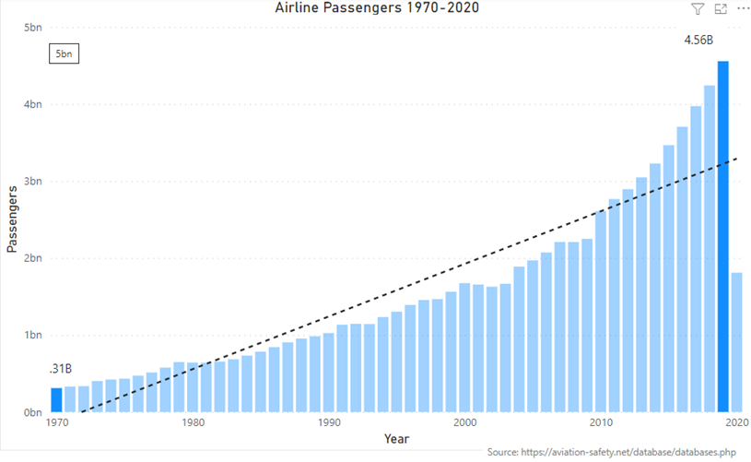

Airline Travel up by 1368%!
Notes:
Speaker: In 2019, the year before the Covid-19 pandemic really pushed air travel down, our industry moved 4.56 billion people. Since 1970, airline travel has increased by over 1300%! From the chart above, you see that trend increasing travel from 1970 through 2019. This is really incredible growth and it shows that airline travelers see the value and safety in traveling by air.

Slide 4

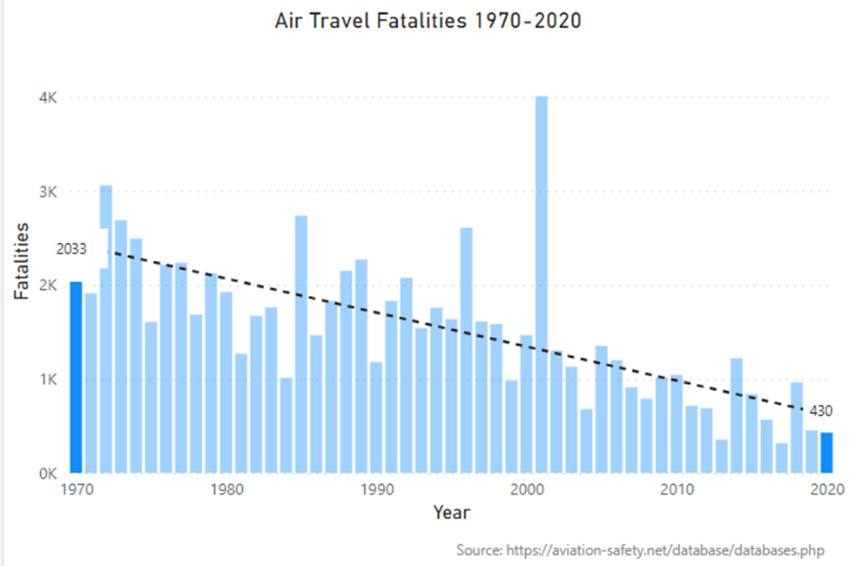

How Safe is it to take a Plane?
Notes:
Speaker: Here is our first look at airline fatalities from 1970 through 2020. You can clearly see from the trendline that our industry continues to improve our already exemplary safety record. In fact, since 1970, airline fatalities have decreased an astounding 79%. The annual risk that you will be killed in a plane crash are 1 in 11 million. Did you know the odds that you’ll be struck by lightning in a given year are just over 1 in 1 million?

Slide 5
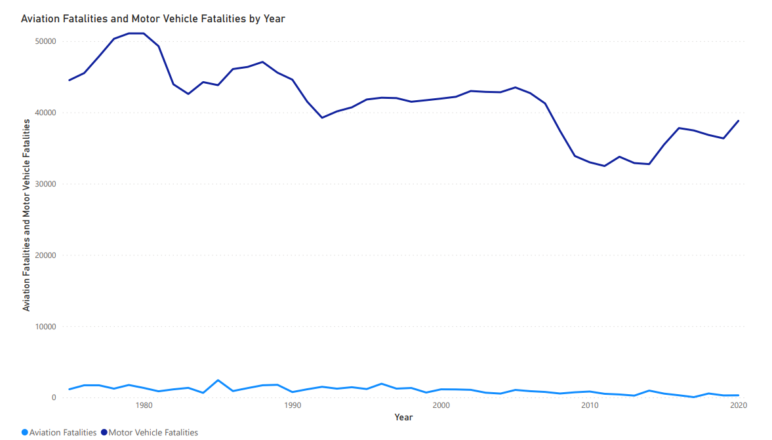
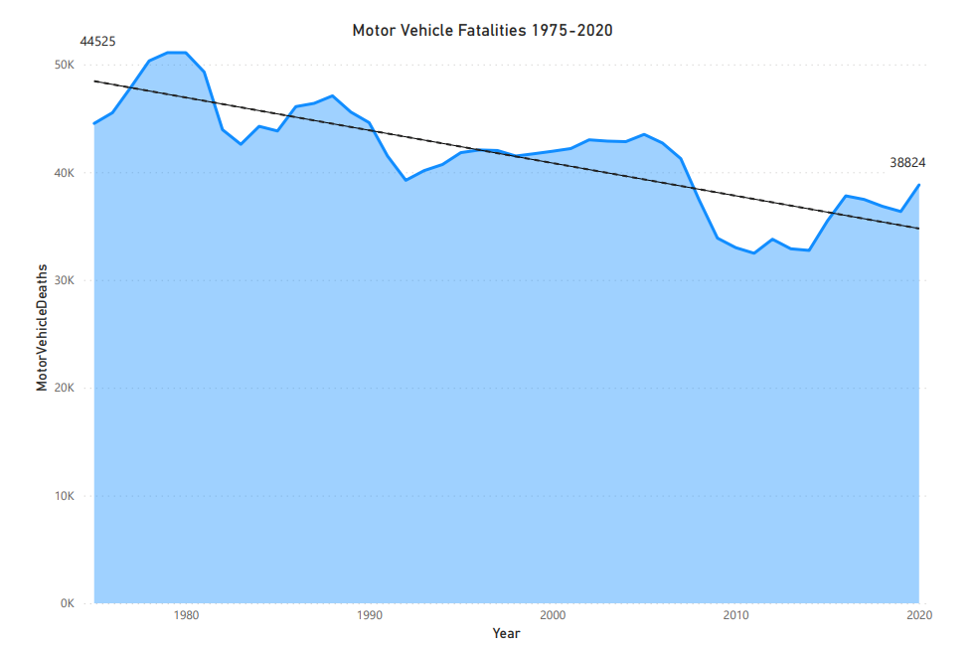
Airline Travel Compared to Auto Travel
Notes:
Speaker: Over the past week, the media has inferred that automobile travel may be becoming safer to utilize over air travel. We can easily see here, that is not even close to being true. From 1975 through 2020, auto travel fatalities decreased by 12.8%, from approx. 44k to 38k.
When running both of these values on the same chart, it becomes almost incomparable. The numbers are so far apart, that we wouldn’t want to use this visualization with our media partners, but I wanted to include it in this meeting to show this group the difference.

Slide 6


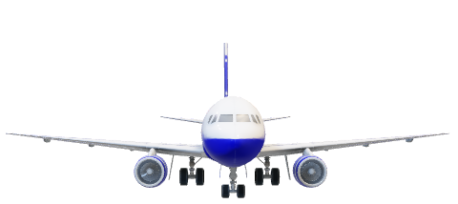
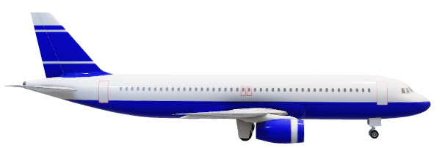
Airline Travel, it really is the Safest!
Notes:
Speaker: This was a quick video, but hopefully, you’ll come away today knowing the facts around the safety of airline travel. We’re still the safest way to travel. Take care!

